Slide 1
CAP442 Web Technology
Unit II
Session 1
II Year M.C.A

Slide 2
Contents
Java Scripit
Functions
Anonymous functions
Scope of variables

Slide 3
Functions
A JavaScript function is a block of code designed to perform a particular task.
A JavaScript function is executed when "something" invokes it (calls it).
JavaScript functions are defined with the function keyword.
Function Declarations
function functionName(parameters) {
// code to be executed
}

Slide 4
A JavaScript function is defined with the function keyword, followed by a name, followed by parentheses ().
Function names can contain letters, digits, underscores, and dollar signs (same rules as variables).
The parentheses may include parameter names separated by commas:
(parameter1, parameter2, ...)
The code to be executed, by the function, is placed inside curly brackets: {}
function name(parameter1, parameter2, parameter3) {
// code to be executed
}

Slide 5
Function parameters are listed inside the parentheses () in the function definition.
Function arguments are the values received by the function when it is invoked.
Inside the function, the arguments (the parameters) behave as local variables.
Declared functions are not executed immediately. They are "saved for later use", and will be executed later, when they are invoked (called upon).
Example
function myFunction(a, b) {
return a * b;
}

Slide 6
Function Invocation
The code inside the function will execute when "something" invokes (calls) the function:
When an event occurs (when a user clicks a button)
When it is invoked (called) from JavaScript code
Automatically (self invoked)

Slide 7
Function Return
When JavaScript reaches a return statement, the function will stop executing.
If the function was invoked from a statement, JavaScript will "return" to execute the code after the invoking statement.
Functions often compute a return value. The return value is "returned" back to the "caller":
Example

Slide 8
Example
Calculate the product of two numbers, and return the result:
let x = myFunction(4, 3); // Function is called, return value will end up in x
function myFunction(a, b) {
return a * b; // Function returns the product of a and b
}
The result in x will be:
12

Slide 9
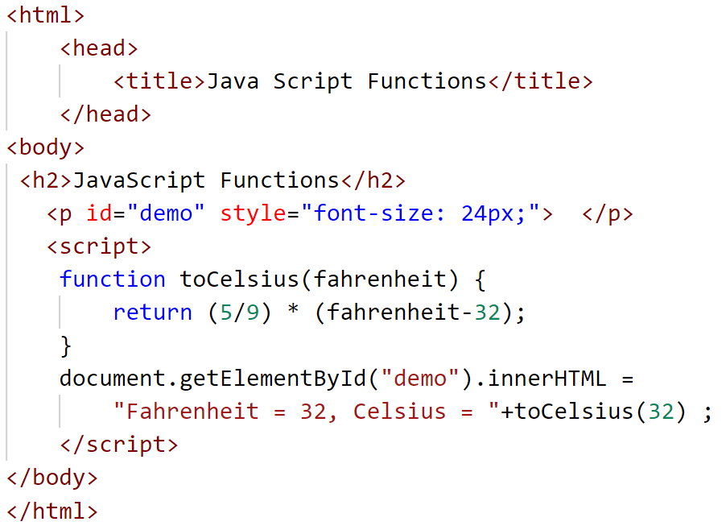
Example: Fahrenheit to Celsius conversion

Slide 10
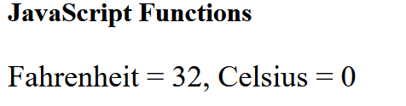
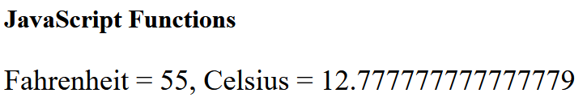
Output

Slide 11
Why Functions?
You can reuse code: Define the code once, and use it many times.
You can use the same code many times with different arguments, to produce different results.
Example
Convert Fahrenheit to Celsius:
function toCelsius(fahrenheit) {
return (5/9) * (fahrenheit-32);
}
document.getElementById("demo").innerHTML = toCelsius(77);

Slide 12
The () Operator Invokes the Function
Using the example above, toCelsius refers to the function object, and toCelsius() refers to the function result.
Accessing a function without () will return the function object instead of the function result.
Example
function toCelsius(fahrenheit) {
return (5/9) * (fahrenheit-32);
}
document.getElementById("demo").innerHTML = toCelsius;
Result: function toCelsius(f) { return (5/9) * (f-32); }

Slide 13
Functions Used as Variable Values
Functions can be used the same way as you use variables, in all types of formulas, assignments, and calculations.
Example
Instead of using a variable to store the return value of a function:
let x = toCelsius(77);
let text = "The temperature is " + x + " Celsius";
You can use the function directly, as a variable value:
let text = "The temperature is " + toCelsius(77) + " Celsius";

Slide 14
Local Variables
Variables declared within a JavaScript function, become LOCAL to the function.
Local variables can only be accessed from within the function.
Example
// code here can NOT use carName
function myFunction() {
let carName = "Volvo";
// code here CAN use carName
}
// code here can NOT use carName
Since local variables are only recognized inside their functions, variables with the same name can be used in different functions.
Local variables are created when a function starts, and deleted when the function is completed.

Slide 15
Anonymous function
A JavaScript function can also be defined using an expression and can be stored in a variable:
Example
const x = function (a, b) {return a * b};
After this, the variable can be used as a function:
Example
const x = function (a, b) {return a * b};
let z = x(4, 3);
The function above is actually an anonymous function (a function without a name).
Functions stored in variables do not need function names. They are always invoked (called) using the variable name.

Slide 16
The Function() Constructor
As you have seen in the previous examples, JavaScript functions are defined with the function keyword.
Functions can also be defined with a built-in JavaScript function constructor called Function().
Example
const myFunction = new Function("a", "b", "return a * b");
let x = myFunction(4, 3);
You actually don't have to use the function constructor. The example above is the same as writing:
Example
const myFunction = function (a, b) {return a * b};
let x = myFunction(4, 3);

Slide 17
Self-Invoking Functions
Function expressions can be made "self-invoking".
A self-invoking expression is invoked (started) automatically, without being called.
Function expressions will execute automatically if the expression is followed by ().
You cannot self-invoke a function declaration.
You have to add parentheses around the function to indicate that it is a function expression:
Example
(function () {
let x = "Hello!!"; // I will invoke myself
})();
The function above is actually an anonymous self-invoking function (function without name).

Slide 18
Scope
JavaScript Scope
Scope determines the accessibility (visibility) of variables.
JavaScript has 3 types of scope:
Block scope
Function scope
Global scope
Block Scope
Earlier JavaScript had only Global Scope and Function Scope.
Later introduced two important new JavaScript keywords: let and const.
These two keywords provide Block Scope in JavaScript.

Slide 19
Variables declared inside a { } block cannot be accessed from outside the block:
Example
{
let x = 2;
}
// x can NOT be used here
Variables declared with the var keyword can NOT have block scope.
Variables declared inside a { } block can be accessed from outside the block.
Example
{
var x = 2;
}
// x CAN be used here

Slide 20
Local Scope
Variables declared within a JavaScript function, become LOCAL to the function.
Example
// code here can NOT use carName
function myFunction() {
let carName = "Volvo";
// code here CAN use carName
}
// code here can NOT use carName

Slide 21
Local variables have Function Scope:
They can only be accessed from within the function.
Since local variables are only recognized inside their functions, variables with the same name can be used in different functions.
Local variables are created when a function starts, and deleted when the function is completed.
Function Scope
JavaScript has function scope: Each function creates a new scope.
Variables defined inside a function are not accessible (visible) from outside the function.
Variables declared with var, let and const are quite similar when declared inside a function.

Slide 22
They all have Function Scope:
function myFunction() {
var carName = "Volvo"; // Function Scope
}
function myFunction() {
let carName = "Volvo"; // Function Scope
}
function myFunction() {
const carName = "Volvo"; // Function Scope
}

Slide 23
Global JavaScript Variables
A variable declared outside a function, becomes GLOBAL.
Example
let carName = "Volvo";
// code here can use carName
function myFunction() {
// code here can also use carName
}
A global variable has Global Scope
All scripts and functions on a web page can access it.
Global Scope
Variables declared Globally (outside any function) have Global Scope.
Global variables can be accessed from anywhere in a JavaScript program.

Slide 24
Variables declared with var, let and const are quite similar when declared outside a block.
They all have Global Scope:
var x = 2; // Global scope
let x = 2; // Global scope
const x = 2; // Global scope
JavaScript Variables
In JavaScript, objects and functions are also variables.
Scope determines the accessibility of variables, objects, and functions from different parts of the code.

Slide 25
Automatically Global
If you assign a value to a variable that has not been declared, it will automatically become a GLOBAL variable.
This code example will declare a global variable carName, even if the value is assigned inside a function.
Example
myFunction();
// code here can use carName
function myFunction() {
carName = "Volvo";
}

Slide 26
Global Variables in HTML
With JavaScript, the global scope is the JavaScript environment.
In HTML, the global scope is the window object.
Global variables defined with the var keyword belong to the window object:
Example
var carName = "Volvo";
// code here can use window.carName
Global variables defined with the let keyword do not belong to the window object:
Example
let carName = "Volvo";
// code here can not use window.carName

Slide 27
The Lifetime of JavaScript Variables
The lifetime of a JavaScript variable starts when it is declared.
Function (local) variables are deleted when the function is completed.
In a web browser, global variables are deleted when you close the browser window (or tab)

